Slide 1

MGMT 605 Generalized Linear Models Lecture #2: Linear Models (Book: Generalized Linear Models with Examples in R)
Prof. J. Vazquez

Slide 2
Objective
Understand the fundamentals of Linear Regression
Review Linear Regression theory
Understand why and when linear regression is used
Understand predicted values and residuals

Slide 3




Free Platforms with compute
SAGE
Jupyter Environment
Connection to Moravian server
Languages: R, Python
Use Moravian email
https://sage.moravian.edu/
Jupyter Environment
Connection to Google cloud services
Languages: R, Python
Free tier and Paid subscription
Access to training
https://colab.research.google.com/
Jupyter Environment
Connection to Kaggle server
Languages: R, Python
Free subscription
Access to datasets and challenges
Access to training
https://www.kaggle.com/code

Slide 4



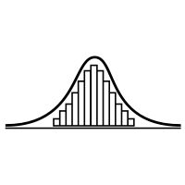



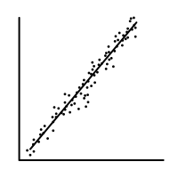
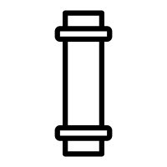
New badges to learn during this lesson:
Stats
Error
Pipes
%>%
Ethics
Linear

Slide 5
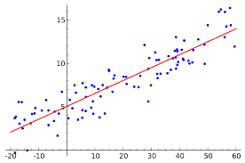
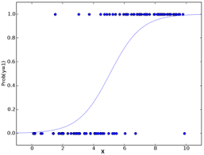
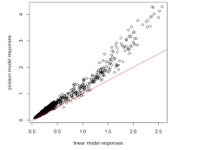
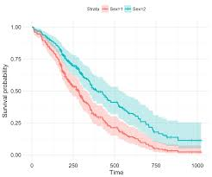
Generalized Linear Models
Linear
Binomial
Count
Survival
Multivariate
Continuous Data
Multivariate
Categorical Data
Multivariate
Count Data
Multivariate
Time Data

Slide 6
Final Project – Grade 25% due by Week 8
Exploration of Generalized Linear Models – select one application for industry and perform a case study.
Logistic Regression
Binary Logistic Regression
Poisson Regression
Survival Models
Machine Learning Approach of any GLM
Schedule
Mid report by week 4 – prepare slides and present progress
Final report by week 8 – final report, final slides and present final results
Requirement: Written report, Power Point slides and reference R code
Final report must include: Abstract, Introduction, Approach, Case Study, Results, Conclusions and References
50% Written Report and R Code
50% Presentation

Slide 7
Required Packages
GLMSDATA -Data sets from the book Generalized Linear Models with Examples in R by Dunn and Smyth.
GGPLOT2
DPLYR
E1071
DMWR
DAAG

Slide 8
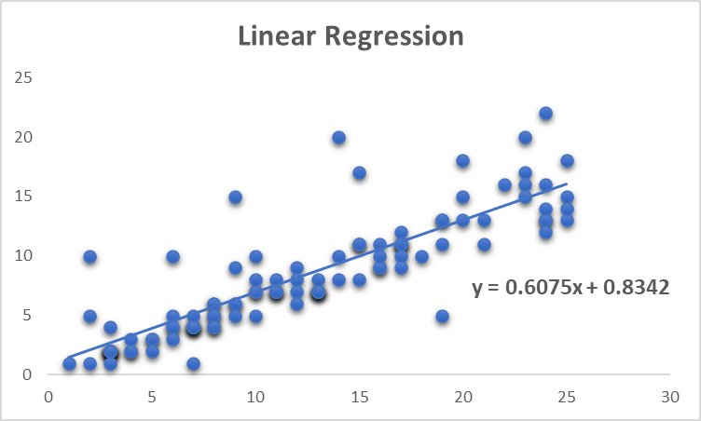
Linear Regression Model
Linear
Definition
A linear relationship is estimated between predictor variables and an outcome variable
R Command
lm(Y ~ X, data = dataframe)

Slide 9
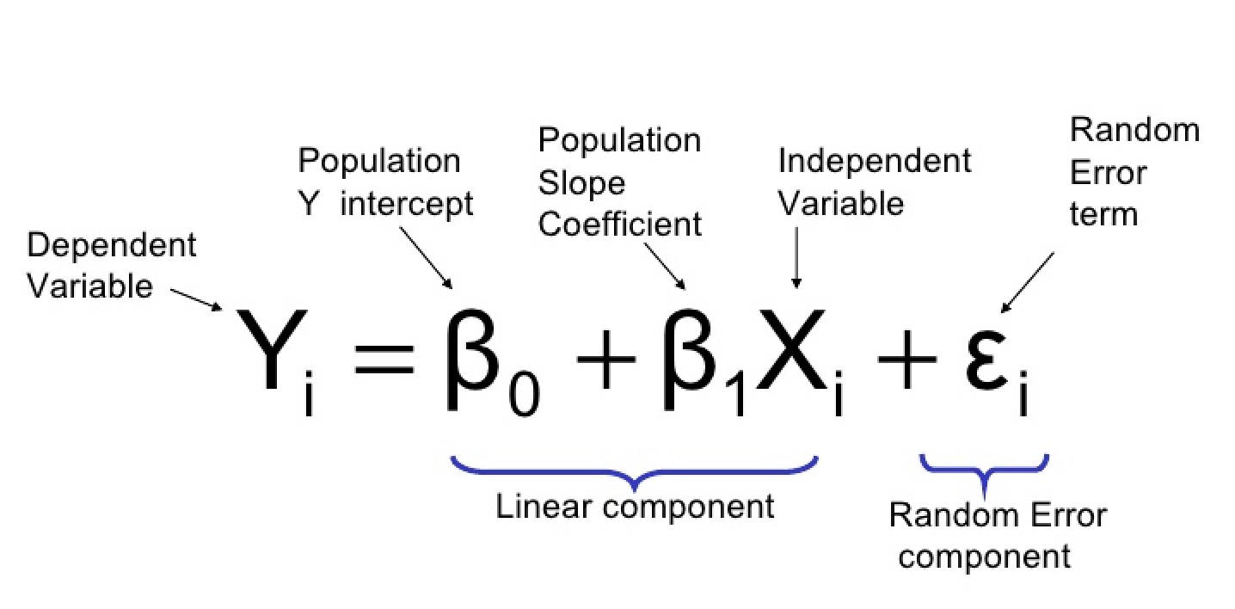
The Linear Regression Equation
The response variable and explanatory variables are both numeric
Relationship between the mean of the response variable and the level of the explanatory variable assumed to be approximately linear (straight line)
β₁ > 0 ⇒ Positive Association
β₁ < 0 ⇒ Negative Association
β₁ = 0 ⇒ No Association

Slide 10
Least Squares Estimation of β₀, β₁
β₀ ≡ Mean response when x=0 (y-intercept)
β₁ ≡ Change in mean response when x increases by 1 unit (slope)
β₀, β₁ are unknown parameters (like μ)
β₀+β₁x ≡ Mean response when explanatory variable takes on the value x
Goal:
Choose values (estimates) that minimize the sum of squared errors (SSE) of observed values to the straight-line:

Slide 11

Example: Olympic Discus Throw
Disc throwing is a track and field event in which an athlete throws a heavy disc (also called a discus) in an attempt to mark a farther distance than their competitors. The metal disc weights 2kg for men and 1kg for women.
Let’s develop a Linear Model:
Age [years] | Average Throwing Distance [feet]
10 | 180
12 | 260
14 | 289
16 | 330
18 | 420
20 | 451

Slide 12
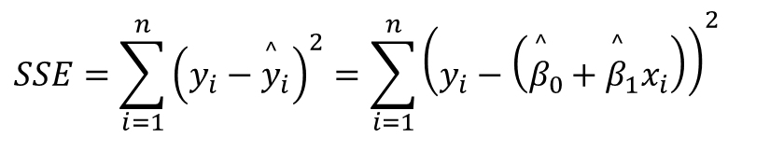
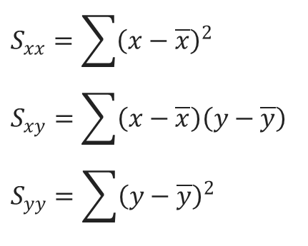

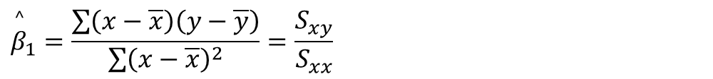
Least Squares Computations
Linear Equation
S: squared estimate of errors
SSE: sum of squared estimate of errors
$$\overset{^}{y}={\overset{^}{β}}_{0}+{\overset{^}{β}}_{1}x$$
$$S_{xx}=\sum{{\left(x−\overline{x}\right)}^{2}} \\ S_{xy}=\sum{\left(x−\overline{x}\right)\left(y−\overline{y}\right)} \\ S_{yy}=\sum{{\left(y−\overline{y}\right)}^{2}}$$
$$SSE=\sum_{i=1}^{n}{{\left(y_{i}−{\overset{^}{y}}_{i}\right)}^{2}}={\sum_{i=1}^{n}{\left(y_{i}−\left({\overset{^}{β}}_{0}+{\overset{^}{β}}_{1}x_{i}\right)\right)}}^{2}$$
Mean response
$${\overset{^}{β}}_{0}=\overline{y}−{\overset{^}{β}}_{1}\overline{x}$$
Change in Mean response
$${\overset{^}{β}}_{1}=\frac{\sum{\left(x−\overline{x}\right)\left(y−\overline{y}\right)}}{\sum{{\left(x−\overline{x}\right)}^{2}}}=\frac{S_{xy}}{S_{xx}}$$

Slide 13
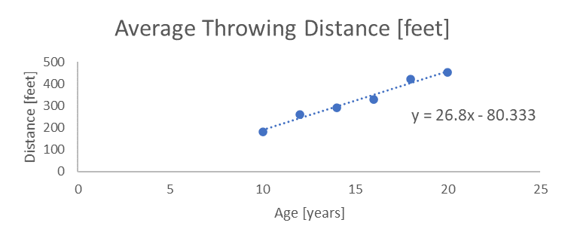
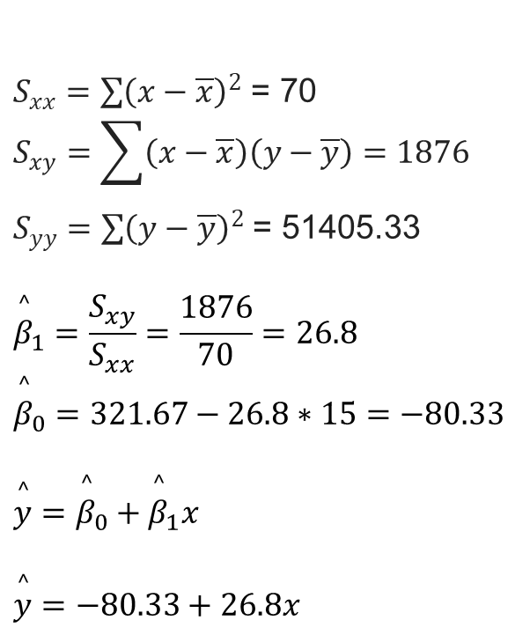
Let’s make a linear regression
Average Age: 15 years
Average Distance: 321.67 feet
$S_{xx}=\sum{{\left(x−\overline{x}\right)}^{2}}$ = 70 $$S_{xy}=\sum{\left(x−\overline{x}\right)\left(y−\overline{y}\right)}=1876$$ $S_{yy}=\sum{{\left(y−\overline{y}\right)}^{2}}$ = 51405.33
$${\overset{^}{β}}_{1}=\frac{S_{xy}}{S_{xx}}=\frac{1876}{70}=26.8$$
$${\overset{^}{β}}_{0}=321.67−26.8∗15=−80.33$$
$$\overset{^}{y}={\overset{^}{β}}_{0}+{\overset{^}{β}}_{1}x$$
$$\overset{^}{y}=−80.33+26.8x$$
Age | Avg Distance | x - x | y - y | Sxx | Sxy | Syy
10 | 180 | -5 | -141.67 | 25 | 708 | 20069.44
12 | 260 | -3 | -61.67 | 9 | 185 | 3802.78
14 | 289 | -1 | -32.67 | 1 | 32.7 | 1067.11
16 | 330 | 1 | 8.33 | 1 | 8.33 | 69.44
18 | 420 | 3 | 98.33 | 9 | 295 | 9669.44
20 | 451 | 5 | 129.33 | 25 | 647 | 16727.11

Slide 14
Correlation Coefficient
- Measures the strength of the linear association between two variables
- Takes on the same sign as the slope estimate from the linear regression
- Not effected by linear transformations of y or x
- Does not distinguish between dependent and independent variable (e.g. height and weight)
- Population Parameter - r
- Pearson’s Correlation Coefficient:

Slide 15
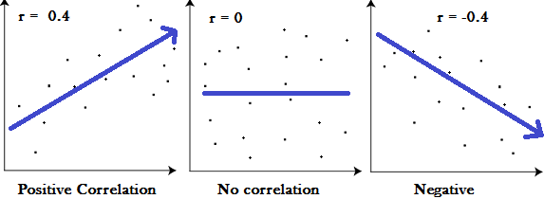
Correlation Coefficient
Useful in finding how strong a relationship is between data.
Interpretation:
+1 indicates a strong positive relationship
-1 indicates a strong negative relationship
A result of zero indicates no relationship at all

Slide 16

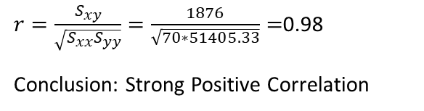
Is there correlation?
Average Age: 15 years
Average Distance: 321.67 feet
$S_{xx}=\sum{{\left(x−\overline{x}\right)}^{2}}$ = 70 $$S_{xy}=\sum{\left(x−\overline{x}\right)\left(y−\overline{y}\right)}=1876$$ $S_{yy}=\sum{{\left(y−\overline{y}\right)}^{2}}$ = 51405.33
$${\overset{^}{β}}_{1}=\frac{S_{xy}}{S_{xx}}=\frac{1876}{70}=26.8$$
$${\overset{^}{β}}_{0}=321.67−26.8∗15=−80.33$$
$$\overset{^}{y}={\overset{^}{β}}_{0}+{\overset{^}{β}}_{1}x$$
$$\overset{^}{y}=−80.33+6.8x$$
$r=\frac{S_{xy}}{\sqrt{S_{xx}S_{yy}}}=\frac{1876}{\sqrt{70∗51405.33}}=$0.98
Conclusion: Strong Positive Correlation
Important to know that:
In statistics, the phrase "correlation does not imply causation" refers to the inability to legitimately deduce a cause-and-effect relationship between two variables solely on the basis of an observed association or correlation between them.

Slide 17
Correlation Coefficient
Values close to 1 in absolute value mean strong linear association, positive or negative from sign
Values close to 0 imply little or no association
If data contain outliers (are non-normal), Spearman’s coefficient of correlation can be computed based on the ranks of the x and y values
Coefficient of Determination (r²) - Proportion of variation in y “explained” by the regression on x:

Slide 18
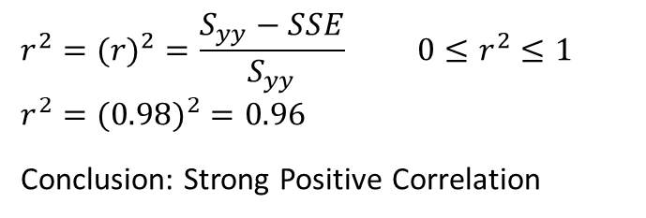
Is there correlation?
Average Age: 15 years
Average Distance: 321.67 feet
$S_{xx}=\sum{{\left(x−\overline{x}\right)}^{2}}$ = 70 $$S_{xy}=\sum{\left(x−\overline{x}\right)\left(y−\overline{y}\right)}=1876$$ $S_{yy}=\sum{{\left(y−\overline{y}\right)}^{2}}$ = 51405.33
$${\overset{^}{β}}_{1}=\frac{S_{xy}}{S_{xx}}=\frac{1876}{70}=26.8$$
$${\overset{^}{β}}_{0}=321.67−26.8∗15=−80.33$$
$$\overset{^}{y}={\overset{^}{β}}_{0}+{\overset{^}{β}}_{1}x$$
$$\overset{^}{y}=−80.33+6.8x$$
$$r^{2}=(r)^{2}=\frac{S_{yy}−SSE}{S_{yy}} 0≤r^{2}≤1$$
$$r^{2}=(0.98)^{2}=0.96$$
Conclusion: Strong Positive Correlation

Slide 19
More than 1 variable?
The simple linear regression model is univariate
When wanting to study the relationship between a dependent and two or more independent variables we need to use the “Multiple Linear Regression” model
Linear Regression
Single Predictor
X Y
Multiple Regression
Multiple Predictor
X₁
X₂
X₃ Y
X₄
X₅

Slide 20
Example of a multivariate problem
Mortality on patients who are smokers
Variables
Cholesterol
Age
Weight
Number of Cigarettes per date
Mortality
Cholesterol
Age
Weight Y
Number of Cigarettes

Slide 21
Multiple Regression
The linear model can be applied with multivariate data.
Numeric Response variable (Y)
p Numeric predictor variables
Model:
Y = β₀ + β₁x₁ + ⋅⋅⋅ + β_{p}x_{p} + ε
Partial Regression Coefficients: β_{i} ≡ effect (on the mean response) of increasing the i^{th} predictor variable by 1 unit, holding all other predictors constant

Slide 22

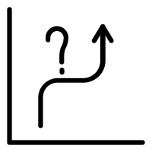

Linear Regression Goals
Prediction – forecast or event in the future based on estimation.
Explanation – exploratory analysis to determine relationships
Theory Building - to test the theoretical hypotheses so there is an emphasis on both theoretically meaningful relationships and determining whether each relationship is statistically significant

Slide 23
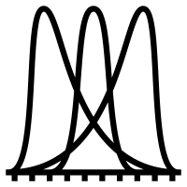
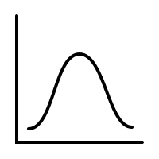
Assumptions in Linear Regression Models
Independence: the scores of any particular subject are independent of the scores of all other subjects
Normality: in the population, the scores on the dependent variable are normally distributed for each of the possible combinations of the level of the X variables; each of the variables is normally distributed
Homoscedasticity: in the population, the variances of the dependent variable for each of the possible combinations of the levels of the X variables are equal.
Linearity: In the population, the relation between the dependent variable and the independent variable is linear when all the other independent variables are held constant.

Slide 24
Simple vs. Multiple Regression Models
Linear Regression
Single Predictor
X Y
Multiple Regression
Multiple Predictor
X₁
X₂
X₃ Y
X₄
X₅
One dependent variable Y predicted from one independent variable X
One regression coefficient
r²: proportion of variation in dependent variable Y predictable from X
One dependent variable Y predicted from a set of independent variables (X1, X2 ….Xk)
One regression coefficient for each independent variable
R²: proportion of variation in dependent variable Y predictable by set of independent variables (X’s)

Slide 25
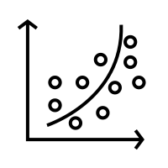
Relationship between variables is important
Linear Relationship
Curvilinear Relationship

Slide 26
Strong vs. Weak Relationships
Y
Y
Y
X
X
X
Strong Relationship
Weak Relationship
No Relationship
Some charts from : Statistics for Managers Using Microsoft® Excel 4th Edition, 2004 Prentice-Hall

Slide 27
Residuals
Error
The residual for observation i, ei, is the difference between its observed and predicted value
Check the assumptions of regression by examining the residuals
Examine for linearity assumption
Examine for constant variance for all levels of X (homoscedasticity)
Evaluate normal distribution assumption
Evaluate independence assumption
Graphical Analysis of Residuals
Can plot residuals vs. X
RESIDUAL = Observed - Predicted

Slide 28
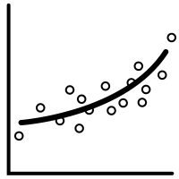
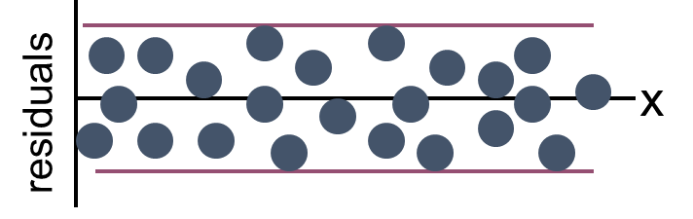
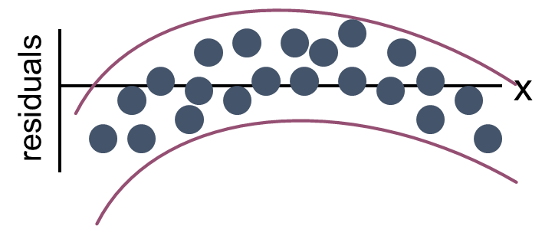
Residuals – Linearity Assumption
Review by plotting the residuals what’s the relationship (Linear or Not Linear)
Linear Relationship
Not Linear Relationship
Some charts from : Statistics for Managers Using Microsoft® Excel 4th Edition, 2004 Prentice-Hall

Slide 29
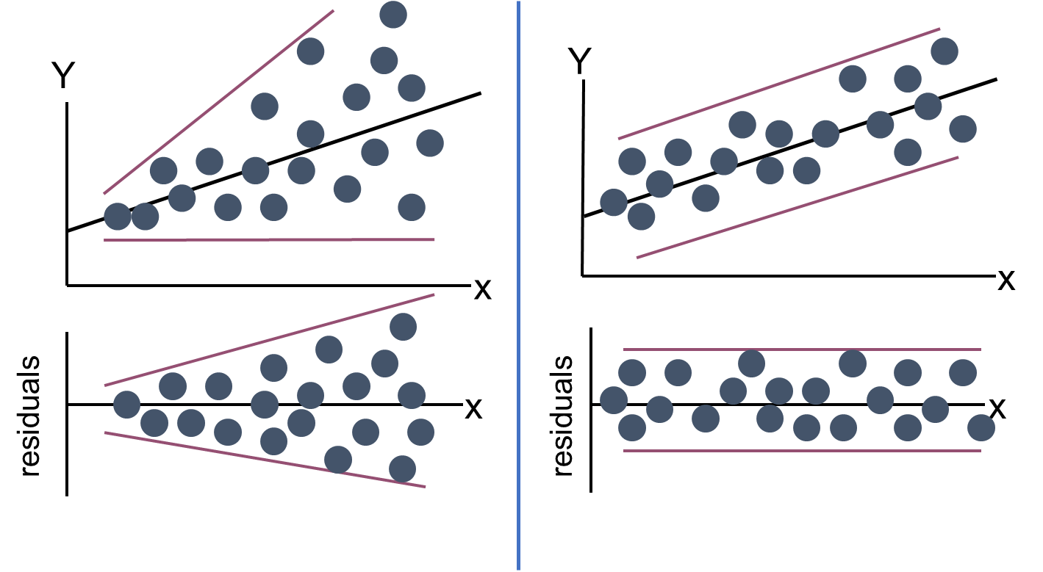
Residuals – Homoscedasticity Assumption
Review by plotting the residuals what’s the relationship (Linear or Not Linear)
Non-Constant Variance
Constant Variance
Some charts from : Statistics for Managers Using Microsoft® Excel 4th Edition, 2004 Prentice-Hall

Slide 30
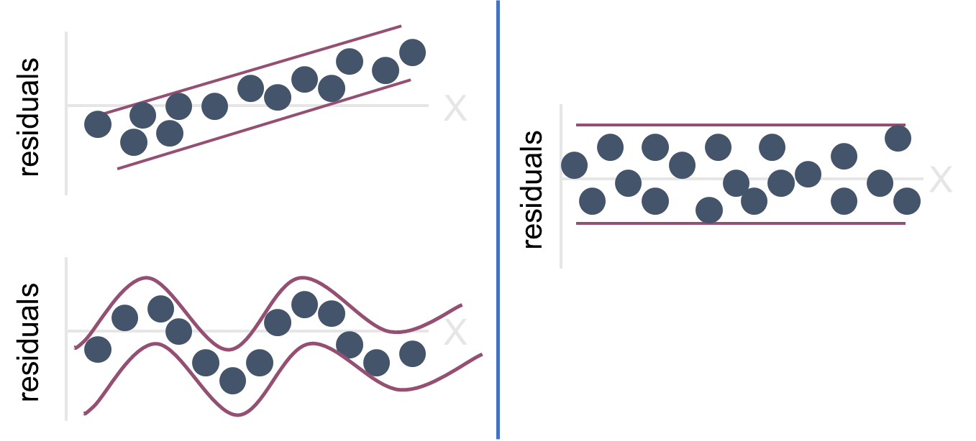
Residuals – Independence Assumption
Review by plotting the residuals what’s the relationship (Linear or Not Linear)
Not Independent
Independent
Some charts from : Statistics for Managers Using Microsoft® Excel 4th Edition, 2004 Prentice-Hall

Slide 31
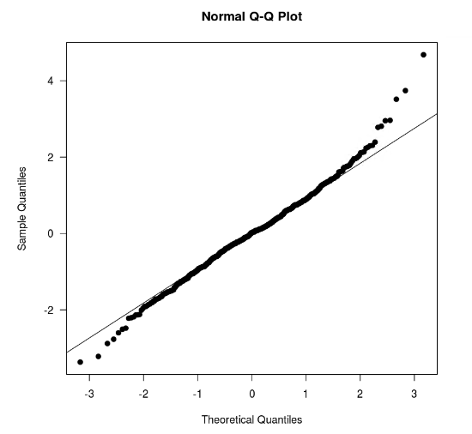
Q-Q plots and Normality
Assumption of normality can be check by using a normal quantile-quantile plot or normal Q-Q plot in R.

Slide 32
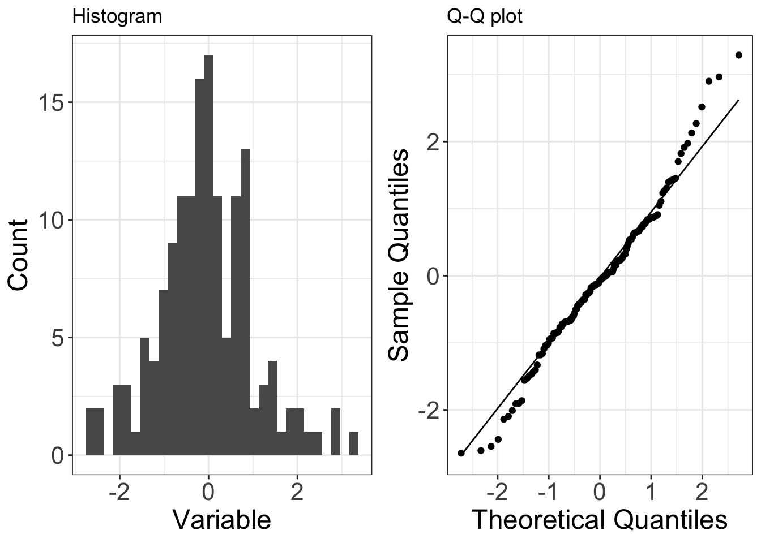
Q-Q plots and Normality
Normal Distribution Properties
Symetric
No Skew
Charts from : https://www.ucd.ie/ecomodel/Resources/QQplots_WebVersion.html

Slide 33
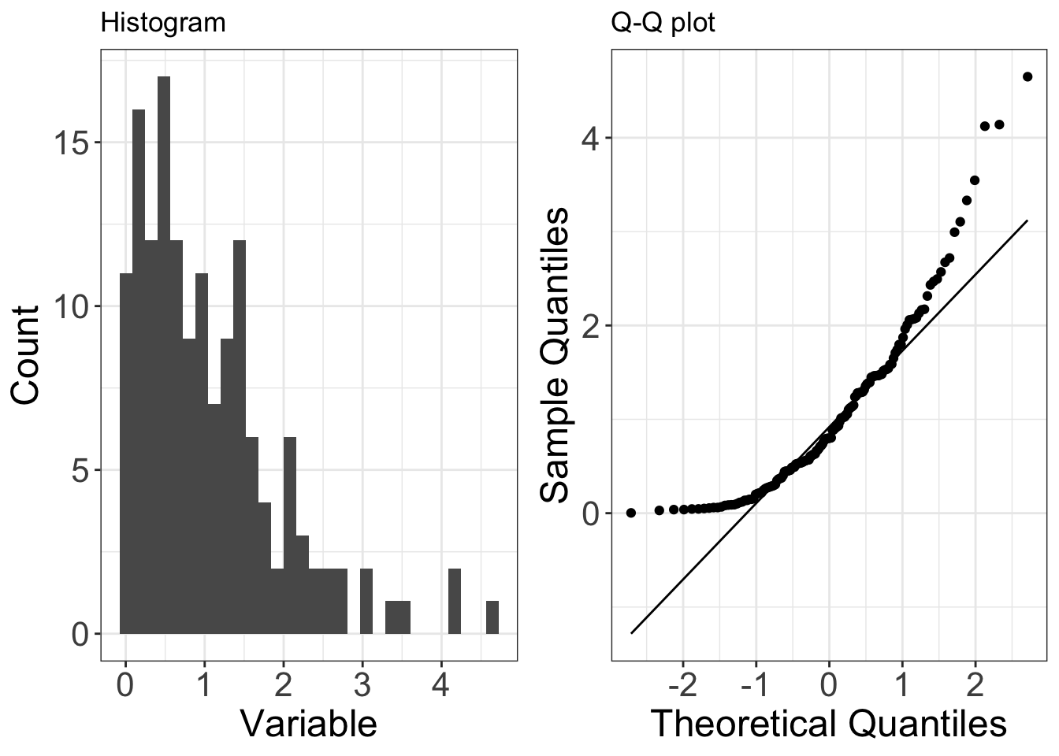
Q-Q plots and Normality
Right Skewed Distributions
Also known as positive skew
Does not fit the line in the Q-Q plot
Charts from : https://www.ucd.ie/ecomodel/Resources/QQplots_WebVersion.html

Slide 34
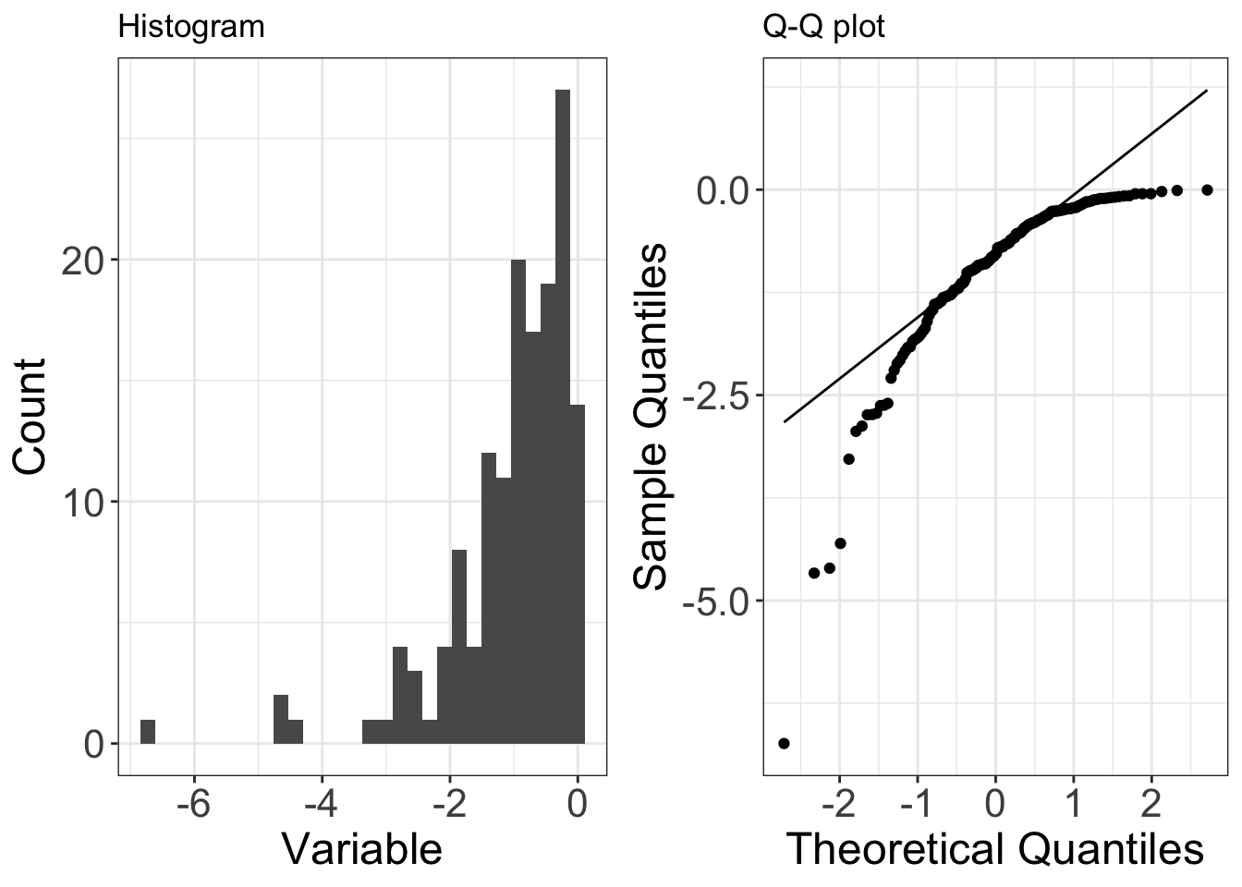
Q-Q plots and Normality
Left Skewed Distributions
Also known as negative skew
Does not fit the line in the Q-Q plot
Charts from : https://www.ucd.ie/ecomodel/Resources/QQplots_WebVersion.html

Slide 35
Other Considerations
Multi-collinearity: when two variables that measure the same thing or similar things (e.g., weight and BMI).
Residual Confounding: cannot completely wipe out confounding simply by adjusting for variables in multiple regression unless variables are measured with zero error
Overfitting: you can get highly significant but meaningless results if you put too many predictors in the model. The model is fit perfectly to the quirks of your particular sample, but has no predictive ability in a new sample.

Slide 36
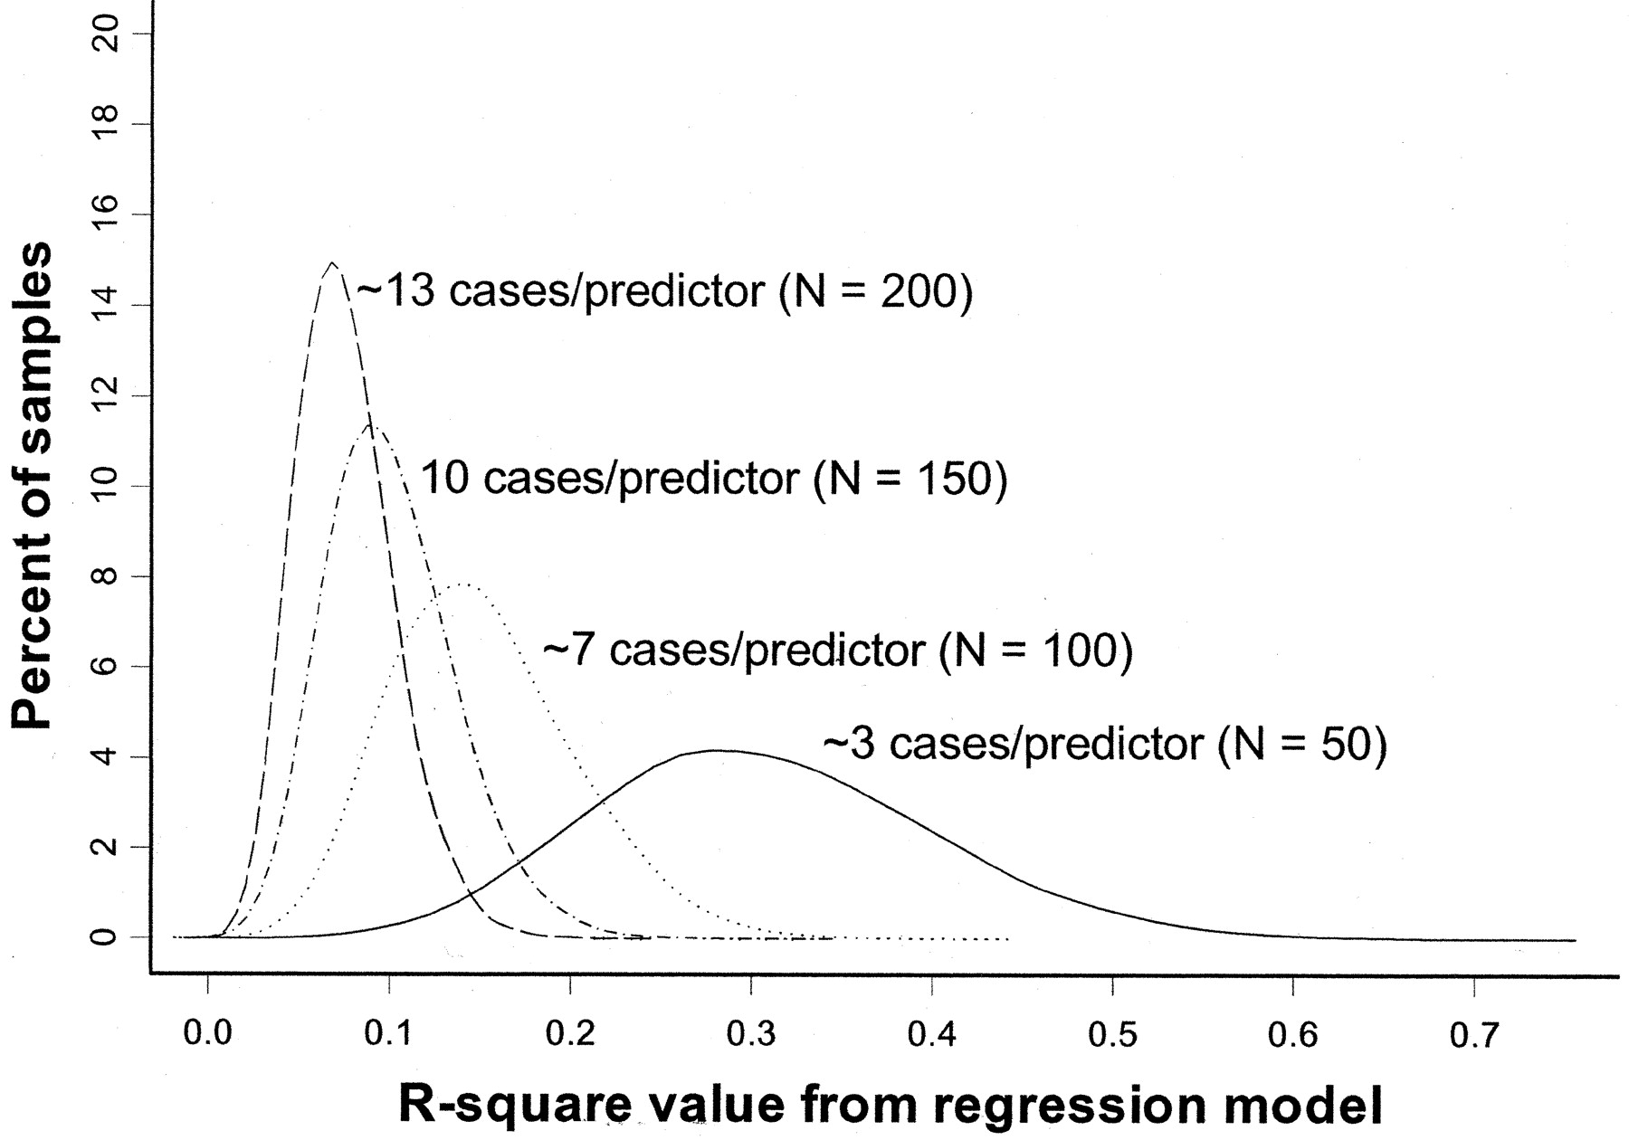
Overfitting
Rule of thumb: You need at least 10 subjects for each additional predictor variable in the multivariate regression model.
Pure noise variables still produce good R² values if the model is overfitted. The distribution of R² values from a series of simulated regression models containing only noise variables.
(Figure 1 from: Babyak, MA. What You See May Not Be What You Get: A Brief, Nontechnical Introduction to Overfitting in Regression-Type Models. Psychosomatic Medicine 66:411-421 (2004).)

Slide 37
Key metrics for Linear Regression
Metric | Symbol | Definition | R-code
R-squared | R2 | R2 corresponds to the squared correlation between the observed outcome values and the predicted values by the model | library(broom) glance(GLM model)
Root Mean Squared Error | RMSE | Measures the average error performed by the model in predicting the outcome for an observation
Residual Standard Error | RSE | Known as the model sigma, is a variant of the RMSE adjusted for the number of predictors in the model.
Mean Absolute Error | MAE | MAE measures the prediction error. The average absolute difference between observed and predicted outcomes. MAE is less sensitive to outliers compared to RMSE.
Akaike’s Information Criteria | AIC | AIC penalizes the inclusion of additional variables to a model. It adds a penalty that increases the error when including additional terms.

Slide 38
Additional Info on Analysis of Residuals
Assumptions for a linear model:
The dataset must have some linear relationship
Multivariate normality - the dataset variables must be statistically Normally Distributed
It must have no or little multicollinearity - this means the independent variables must not be too highly correlated with each other. This can be tested with a Correlation matrix and other tests
No auto-correlation - Autocorrelation occurs when the residuals are not independent from each other. For instance, this typically occurs in stock prices, where the price is not independent from the previous price.
Homoscedasticity - meaning that the residuals are equally distributed across the regression line.
Four standard plots can be accessed using the plot() function in R:
Residuals vs Fitted Plot
Normal Q–Q (quantile-quantile) Plot
Scale-Location
Residuals vs Leverage

Slide 39
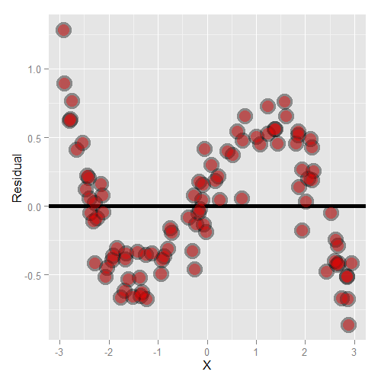
Residuals vs Fitted Plot
Residual plots are used to look for underlying patterns in the residuals that may mean that the model has a problem.
For a correct linear regression, the data needs to be linear so this will test if that condition is met.

Slide 40
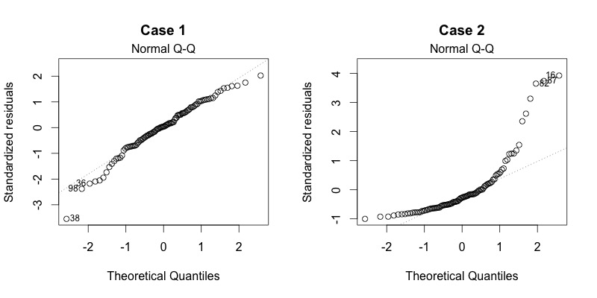
Normal Q–Q (quantile-quantile) Plot
Residuals should be normally distributed.
The Q-Q plot will show if they are normally distributed.
The residuals should follow a straight line in the Q-Q plot.

Slide 41
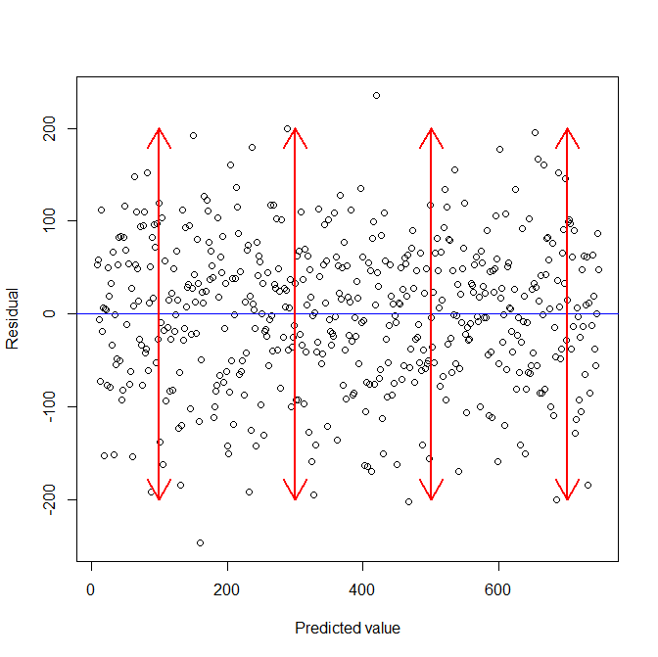
Scale-Location
This plot test the linear regression assumption of equal variance (homoscedasticity) i.e. that the residuals have equal variance along the regression line.

Slide 42
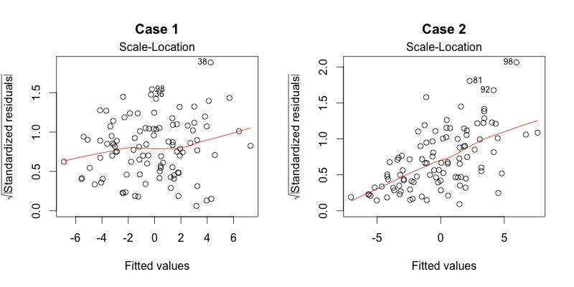
Residuals vs Leverage
This plot can be used to find influential cases in the dataset. An influential case is one that, if removed, will affect the model so its inclusion or exclusion should be considered.

Slide 43
Multivariate Regression techniques for other data types
Multiple linear regression is for normally distributed outcomes
Logistic regression is for binary outcomes
Cox proportional hazards regression is used when time-to-event is the outcome

Slide 44
Example from Textbook
Book: Generalized Linear Models with Examples in R
Chapters 1
Plug the code in R Sage Notebooks – the code is modified to run with GGPLOT and DPLYR packages.

Slide 45
Linear Regression Dataset: Lung capacity and smoking in youth
This dataframe contains 654 observations on the following 5 variables for the health and smoking habits of youth.
Age : the age of the subject in completed years
FEV: the forced expiratory volume in litres, a measure of lung capacity
Ht: the height in inches
Gender: the gender of the subjects: females coded as 0 and males as 1
Smoke: the smoking status of the subject: non-smokers coded as 0 and smokers as 1

Slide 46
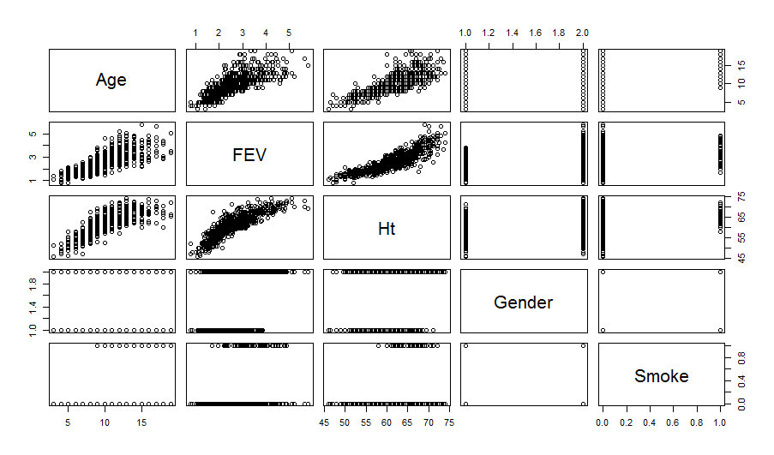
Problem: A study of 654 youth in Boston explored the relationship between lung capacity and smoking status, age, height, and gender. Consider fitting a linear model to the lung capacity data.
Exploratory Analysis
## Load the libraries
library(GLMsData)
library(ggplot2)
library(dplyr)
## Review the dataset
data("lungcap")
str(lungcap)
head(lungcap, 10)
summary(lungcap)
pairs(lungcap)
options(digits=3)
lungcap$Gender <- ifelse(lungcap$Gender == "F", 1, 0)
cor(lungcap)

Slide 47
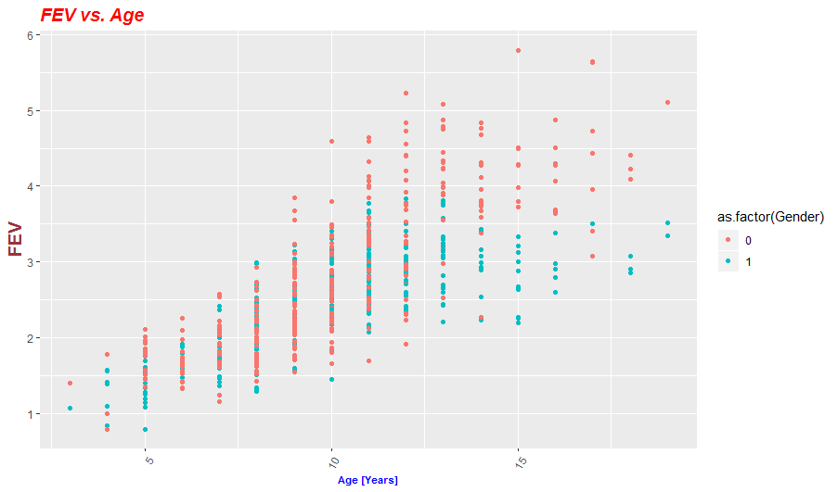
Problem: A study of 654 youth in Boston explored the relationship between lung capacity and smoking status, age, height, and gender. Consider fitting a linear model to the lung capacity data.
Visualize the data
## Plot - FEV vs Age
ggplot(lungcap, aes(x=Age, y=FEV, col= as.factor(Gender))) +geom_point()+ggtitle("FEV vs. Age") +
xlab("Age [Years]") + ylab("FEV")+
theme(
plot.title = element_text(color="red", size=14, face="bold.italic"),
axis.title.x = element_text(color="blue", size=8, face="bold"),
axis.title.y = element_text(color="#993333", size=14, face="bold")
)+ theme(axis.text.x = element_text(angle = 60, hjust = 1))

Slide 48
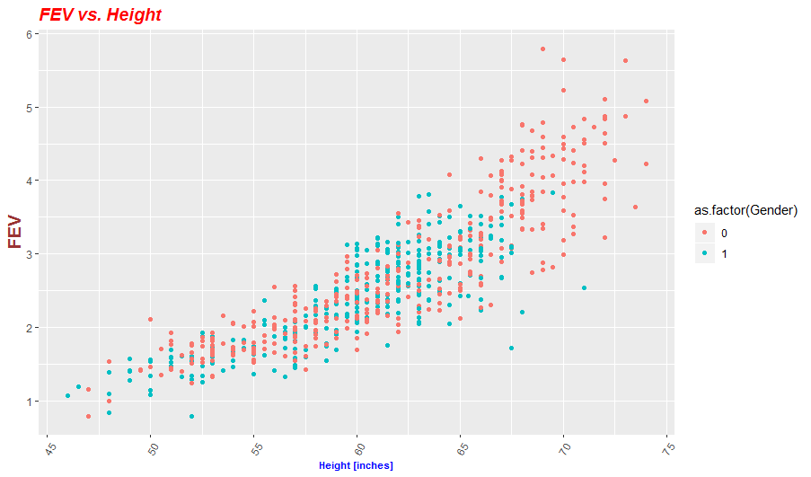
Problem: A study of 654 youth in Boston explored the relationship between lung capacity and smoking status, age, height, and gender. Consider fitting a linear model to the lung capacity data.
Visualize the data
## Plot - FEV vs Height
ggplot(lungcap, aes(x=Ht, y=FEV, col= as.factor(Gender))) +geom_point()+ggtitle("FEV vs. Height") +
xlab("Height [inches]") + ylab("FEV")+
theme(
plot.title = element_text(color="red", size=14, face="bold.italic"),
axis.title.x = element_text(color="blue", size=8, face="bold"),
axis.title.y = element_text(color="#993333", size=14, face="bold")
)+ theme(axis.text.x = element_text(angle = 60, hjust = 1))

Slide 49
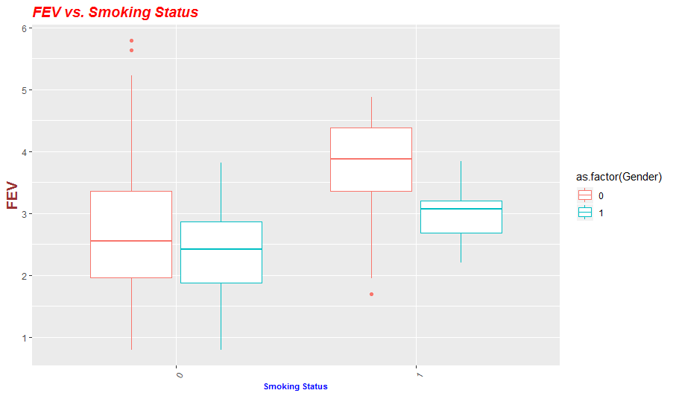
Problem: A study of 654 youth in Boston explored the relationship between lung capacity and smoking status, age, height, and gender. Consider fitting a linear model to the lung capacity data.
Visualize the data
## Plot - FEV vs Gender
ggplot(lungcap, aes(x=as.factor(Smoke), y=FEV, col= as.factor(Gender))) +geom_boxplot()+ggtitle("FEV vs. Smoking Status") +
xlab("Smoking Status") + ylab("FEV")+
theme(
plot.title = element_text(color="red", size=14, face="bold.italic"),
axis.title.x = element_text(color="blue", size=8, face="bold"),
axis.title.y = element_text(color="#993333", size=14, face="bold")
)+ theme(axis.text.x = element_text(angle = 60, hjust = 1))

Slide 50
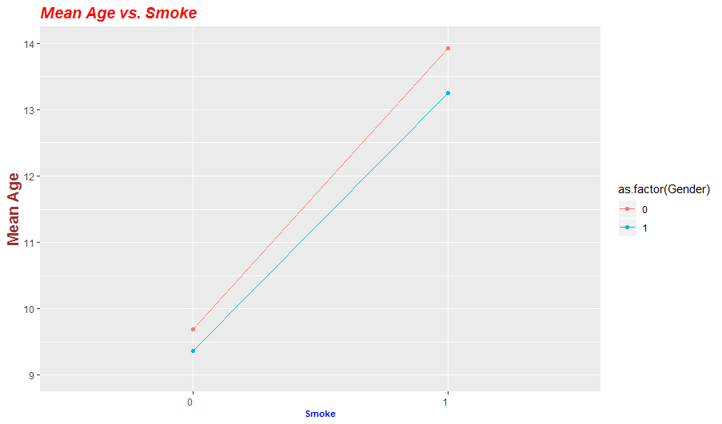
Problem: A study of 654 youth in Boston explored the relationship between lung capacity and smoking status, age, height, and gender. Consider fitting a linear model to the lung capacity data.
Visualize the data
lungcap %>%
group_by(Gender, Smoke) %>%
summarise(Age_groups = mean(Age)) -> lungcap2
lungcap2 %>%
ggplot() +
aes(x = as.factor(Smoke) , y = Age_groups, color = as.factor(Gender)) + ylim(9,14) +
geom_line(aes(group = Gender)) +
geom_point()+
ggtitle("Mean Age vs. Smoke") +
xlab("Smoke") + ylab("Mean Age")+
theme(
plot.title = element_text(color="red", size=14, face="bold.italic"),
axis.title.x = element_text(color="blue", size=8, face="bold"),
axis.title.y = element_text(color="#993333", size=14, face="bold")
)+ theme(axis.text.x = element_text(angle = 0, hjust = 1))

Slide 51
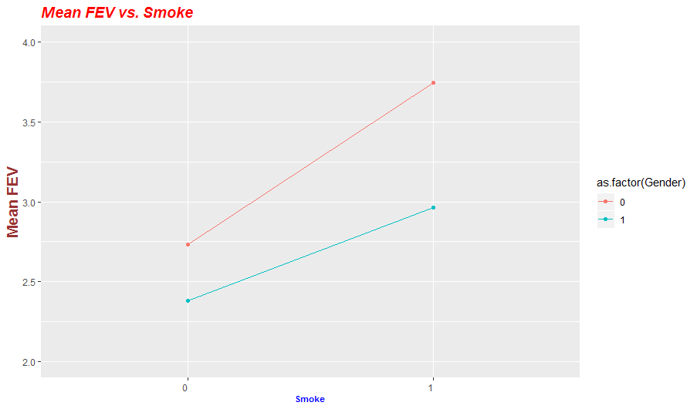
Problem: A study of 654 youth in Boston explored the relationship between lung capacity and smoking status, age, height, and gender. Consider fitting a linear model to the lung capacity data.
Visualize the data
lungcap %>%
group_by(Gender, Smoke) %>%
summarise(FEV_groups = mean(FEV)) -> lungcap3
lungcap3 %>%
ggplot() +
aes(x = as.factor(Smoke) , y = FEV_groups, color = as.factor(Gender)) + ylim(2,4) +
geom_line(aes(group = Gender)) +
geom_point()+
ggtitle("Mean FEV vs. Smoke") +
xlab("Smoke") + ylab("Mean FEV")+
theme(
plot.title = element_text(color="red", size=14, face="bold.italic"),
axis.title.x = element_text(color="blue", size=8, face="bold"),
axis.title.y = element_text(color="#993333", size=14, face="bold")
)+ theme(axis.text.x = element_text(angle = 0, hjust = 1))

Slide 52
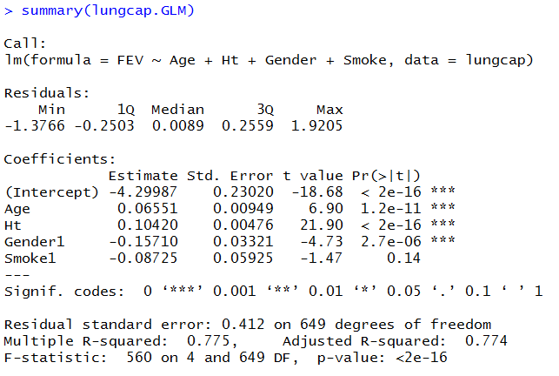
Problem: A study of 654 youth in Boston explored the relationship between lung capacity and smoking status, age, height, and gender. Consider fitting a linear model to the lung capacity data.
Fit a GLM Regressor
## Linear Regression
lungcap$Smoke <- as.factor(lungcap$Smoke)
lungcap$Gender <- as.factor(lungcap$Gender)
lungcap.GLM <- lm(FEV~ Age + Ht + Gender + Smoke, data = lungcap)
lungcap.GLM
# Summary
summary(lungcap.GLM)

Slide 53
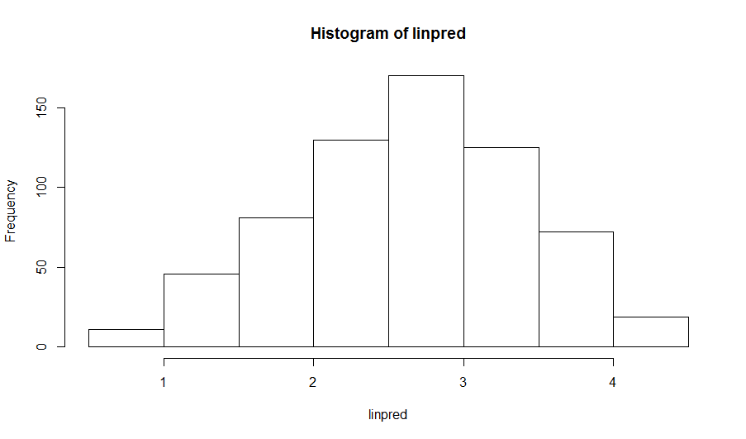
Problem: A study of 654 youth in Boston explored the relationship between lung capacity and smoking status, age, height, and gender. Consider fitting a linear model to the lung capacity data.
Review some metrics
# Coefficients
round(coef(summary(lungcap.GLM)),5)
# Confidence Intervals
confint(lungcap.GLM)
#Anova
anova(lungcap.GLM)
# Visualizing Predictions
linpred <- predict(lungcap.GLM)
hist(linpred)

Slide 54
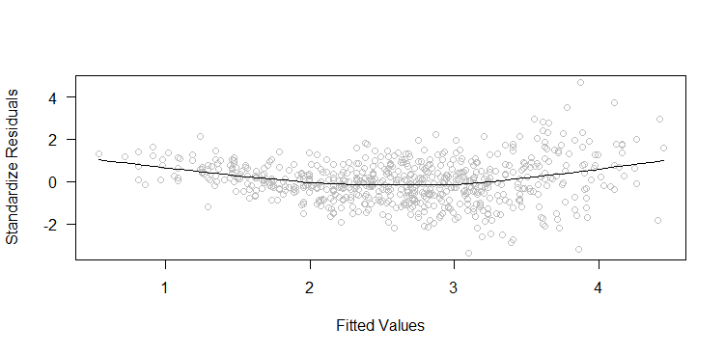
Problem: A study of 654 youth in Boston explored the relationship between lung capacity and smoking status, age, height, and gender. Consider fitting a linear model to the lung capacity data.
Visualize the Error
# Residuals
lungcap$linpred <- predict(lungcap.GLM)
rawres <- lungcap$FEV - predprob
lungcap$rawres <- lungcap$FEV – predprob
plot(rawres~ linpred, xlab="linear predictor", ylab="residuals")
# or you can use this plot from chapter 3:
## Plot residuals against the fitted values
scatter.smooth(rstandard(lungcap.GLM) ~ fitted(lungcap.GLM), col="grey",
las=1, ylab="Standardize Residuals", xlab="Fitted Values")

Slide 55
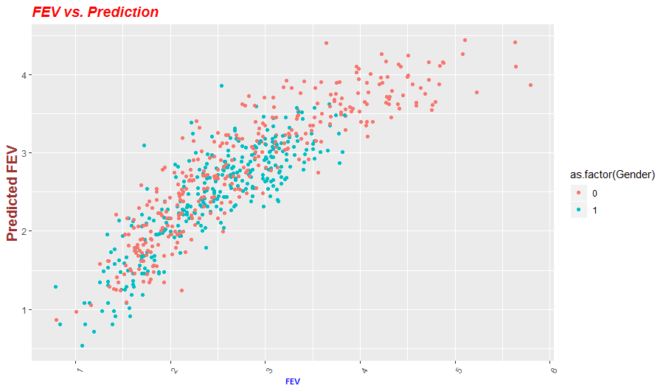
Problem: A study of 654 youth in Boston explored the relationship between lung capacity and smoking status, age, height, and gender. Consider fitting a linear model to the lung capacity data.
Visualize the Predictions
ggplot(lungcap, aes(x=FEV, y=linpred, col= as.factor(Gender))) +geom_point()+ggtitle("FEV vs. Prediction") +
xlab("FEV") + ylab("Predicted FEV")+
theme(
plot.title = element_text(color="red", size=14, face="bold.italic"),
axis.title.x = element_text(color="blue", size=8, face="bold"),
axis.title.y = element_text(color="#993333", size=14, face="bold")
)+ theme(axis.text.x = element_text(angle = 60, hjust = 1))
#Correlation between actual vs. prediction
cor(lungcap$linpred, lungcap$FEV)
88.1% Correlation

Slide 56

Homework: Multivariate Linear Regression Dataset: Utilityweather – Weather and Load data for Utility
This dataframe contains 2,102 observations on the following variables.
Date: date for record
Value: actual load
AVG_TEMP: average temperature
AVG_WIND: average wind
AVG_HUMID: average humidity
CLOUD: cloud coverage
PRESSURE: atmospheric pressure
changeAVG_TEMP: daily temperature change
changeAVG_WIND: daily wind speed change
changeAVG_HUMID: daily humidity change
changeCLOUD: daily cloud coverage change
changePRESSURE: daily atmospheric pressure change
Month: month for reading (1-12)
Week: week for reading (1-52)
Weeday: weekday number (1-7)

Slide 57
Additional Homework
An electric utility is planning the load capacity and would like to have a model for Load based on temperature.
Explore the dataset (Utilityweather.csv)
Fit a GLM regressor
Discuss if a GLM is appropriate
Date | Value | AVG_TEMP | AVG_WIND | AVG_HUMID | CLOUD | PRESSURE | changeAVG_TEMP | changeAVG_WIND | changeAVG_HUMID | changeCLOUD | changePRESSURE | Month | Week | Weeday
1-Jan-14 | 5565.294 | 25.7 | 3.5 | 68.7 | 47.5 | 1026.8 | 0 | 0 | 0 | 0 | 0 | 1 | 1 | 4
2-Jan-14 | 6591.19 | 24.5 | 7.7 | 81.9 | 87.1 | 1014.1 | -1.2 | 4.2 | 13.2 | 39.6 | -12.7 | 1 | 1 | 5
3-Jan-14 | 6938.6 | 10.9 | 11.3 | 63.1 | 37.3 | 1021.2 | -13.6 | 3.6 | -18.8 | -49.8 | 7.1 | 1 | 1 | 6
4-Jan-14 | 6544.775 | 11.9 | 4.2 | 65.9 | 6.1 | 1029.6 | 1 | -7.1 | 2.8 | -31.2 | 8.4 | 1 | 1 | 7
5-Jan-14 | 6009.21 | 22.6 | 3.3 | 85.4 | 54.5 | 1020.6 | 10.7 | -0.9 | 19.5 | 48.4 | -9 | 1 | 2 | 1
6-Jan-14 | 6486.93 | 34.1 | 14.4 | 71 | 69.4 | 1003.5 | 11.5 | 11.1 | -14.4 | 14.9 | -17.1 | 1 | 2 | 2
7-Jan-14 | 7783.846 | 3.1 | 14.9 | 47.7 | 11.8 | 1023.5 | -31 | 0.5 | -23.3 | -57.6 | 20 | 1 | 2 | 3
8-Jan-14 | 7441.848 | 12.4 | 5.3 | 55.4 | 38.3 | 1032.8 | 9.3 | -9.6 | 7.7 | 26.5 | 9.3 | 1 | 2 | 4
9-Jan-14 | 6751.48 | 23.6 | 2.2 | 61.5 | 33.3 | 1035.7 | 11.2 | -3.1 | 6.1 | -5 | 2.9 | 1 | 2 | 5

Slide 58
Preview of Week #8 material
Optional Read

Slide 59
Machine Learning
A field of artificial intelligence, concerned with the design and development of algorithms that allow computers to learn behaviors based on empirical data.
As intelligence requires knowledge, it is necessary for the computers to acquire knowledge.
Within the field of data analytics, machine learning is a method used to devise complex models and algorithms that lend themselves to prediction.

Slide 60
Machine Learning Applications
Classification: inputs are divided into two or more classes, and the learner must produce a model that assigns unseen inputs to one or more of these classes.
Example: Spam filtering "spam" or "not spam"
Regression: the outputs are continuous rather than discrete.
Example: Probabilistic forecasting
Clustering: a set of inputs is to be divided into groups. Unlike in classification, the groups are not known beforehand, making this typically an unsupervised task.
Example: Customer grouping | Elections forecasting
Dimensionality reduction simplifies inputs by mapping them into a lower-dimensional space.
Example: Topic modeling- find out which documents cover similar topics

Slide 61
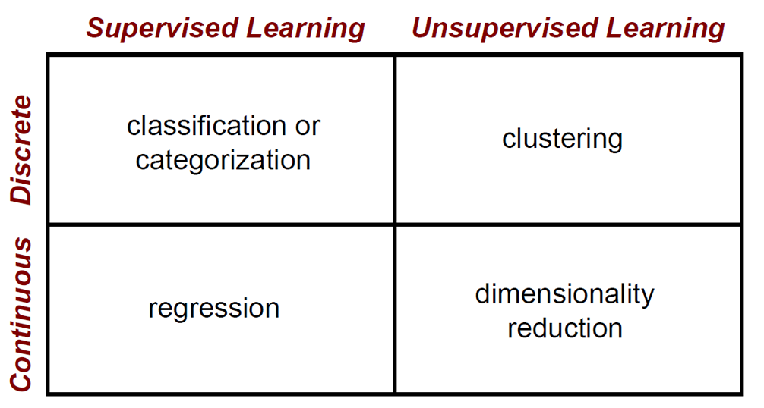
Machine Learning help us find new insights!
Use of data to train a computer model
Goal: Predict new values based on known inputs
How it works?
The model learns from training cases
Then we can use a trained model to predict new data cases f(X) = Y
Features (Observations) | Response Variable
[X1, X2, X3,…] | [Y]
[X1, X2, X3,…] | [Y]
[X1, X2, X3,…] | [Y]
[X1, X2, X3,…] | [Y]

Slide 62
Machine Learning requires good data
Machine Learning Algorithm
How these Algorithms work?
Data Acquisition
Data Preparation
Predictive Model
New Data
Predictions

Slide 63
Train and Test sets
Typically data is split into a Train and Test dataset
Example:
75% Train
25% Test
Data acquisition
Practical usage
Universal set
Training set
Testing set

Slide 64
What’s Training?
Training is the process of making the system able to learn.
Training set and testing set come from the same distribution
Need to make some assumptions or bias

Slide 65
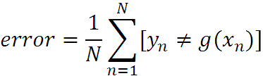
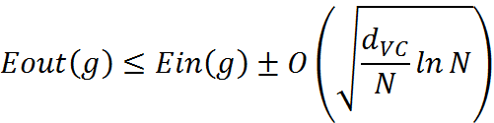
What are we seeking?
Supervised: Low E-out or maximize probabilistic terms
Unsupervised: Minimum quantization error, Minimum distance, MAP, MLE(maximum likelihood estimation)
E-in: for training set
E-out: for testing set

Slide 66




What are we seeking?
Under-fitting VS. Over-fitting (fixed N)
error
(model = hypothesis + loss functions)

Slide 67
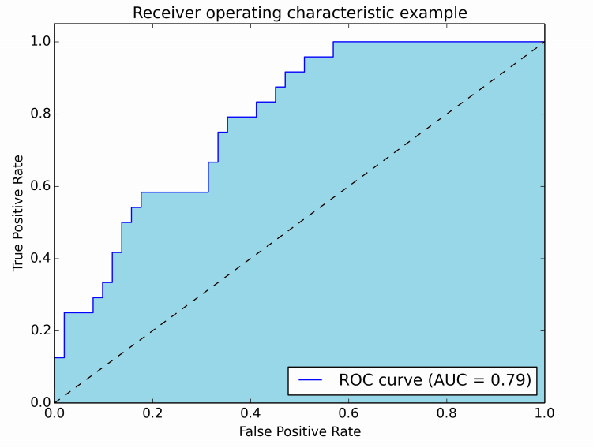


Machine Learning can be scored
How to measure success?
True Positive Rate (TPR)
False Positive Rate (FPR)
Use of ROC curves
Measure the area under the curve
.50 = Random guess
Closer to 1 = better performance
Goal: Decrease FPR
Increase TPR
$$TPR= \frac{TP}{TP+FN}$$
$$FPR= \frac{FP}{FP+TN}$$

Slide 68
https://www.machinelearningplus.com/machine-learn ing/complete-introduction-linear-regression-r/ Example Linear Regression in R

